Slide 1


Premier League scouting for Feyenoord
Cloud Technologies and Big Data Frameworks part 2
Max Noorland
11/02/24
Notes:
Cloud Technologies and Big Data Framework Assignment 2

Slide 2
Table of contents
Introduction of Feyenoord
English Premier League 2022-2023 Season Dataset
Three dataframes
Queries
Scouting a replacement for Santiago Giménez
Scouting Dutch players
Age distribution of young players (<21) in the Premier League
Experience/playing time of the youngsters

Slide 3
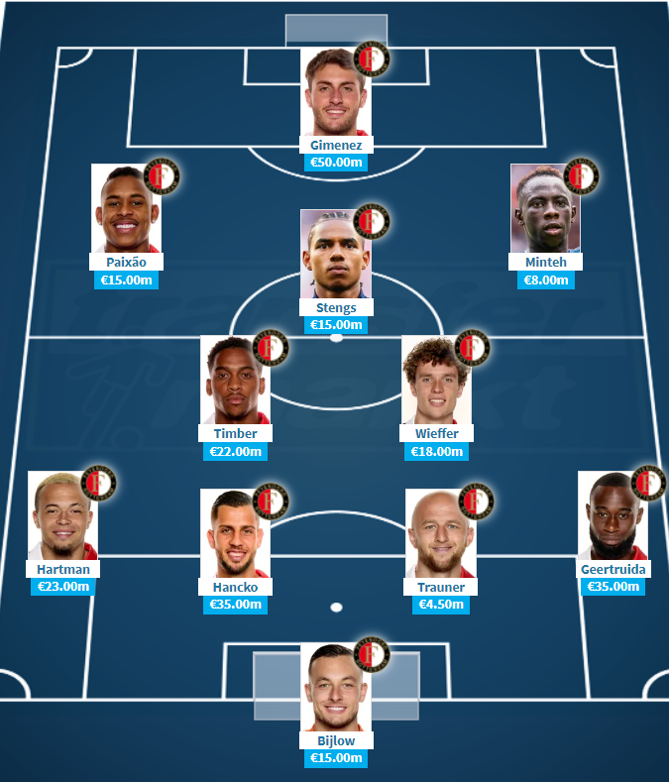
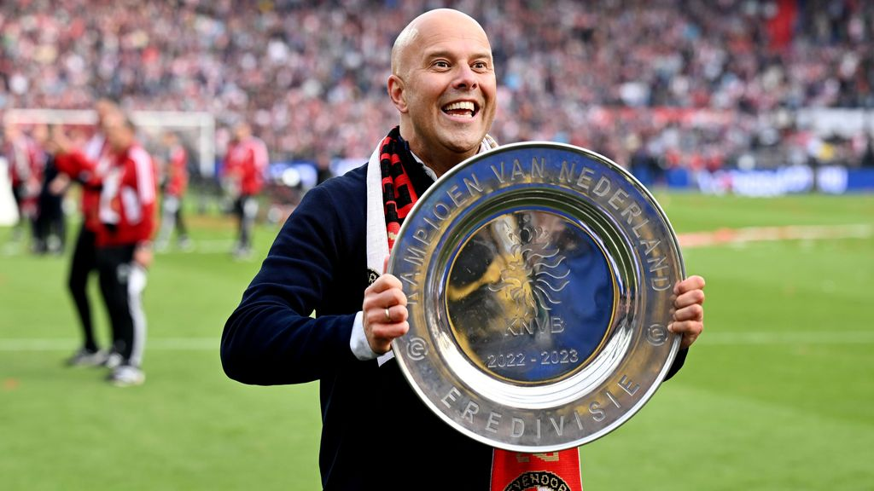
Introduction of Feyenoord
Football club from Rotterdam, The Netherlands
Founded in 1908
Recent success under head coach Arne Slot
Key aspects of Feyenoord’s play style
High pressure tactics
Zonal pressing approach
Adaptability and strategic consistency

Slide 4
English Premier League 2022-2023 Season Stats Dataset
Consists of category-based detailed statistics of each player in the Premier League
Source: Kaggle (https://www.kaggle.com/datasets/mechatronixs/english-premier-league-22-23-season-stats)
Original Data Source: FBref (https://fbref.com/en/comps/9/2022-2023/stats/2022-2023-Premier-League-Stats)

Slide 5

Three dataframes
Forwards dataframe: used for scouting a replacement for current striker Santiago Giménez
Dutch players dataframe: used for scouting players who are more likely to feel at home in The Netherlands
Young players dataframe (<21): used for scouting players who can develop at Feyenoord

Slide 6
Queries
Finding a Santiago Giménez replacement
Compared Santi’s statistics with Premier League forwards to find similar players
Most interesting Dutch players
Ranked Dutch players based on performance metric and age
Age distribution of young players (under 21):
Grouped the young players by age and counted the number of players in each group
Average matches played per age group:
Calculated the average matches played for each age group
Scatter plot comparing age with experience
Selected columns ‘Player’, ‘Age’, and ‘Match_Play’ of young players and sorted them by the number of matches played in descending order

Slide 7
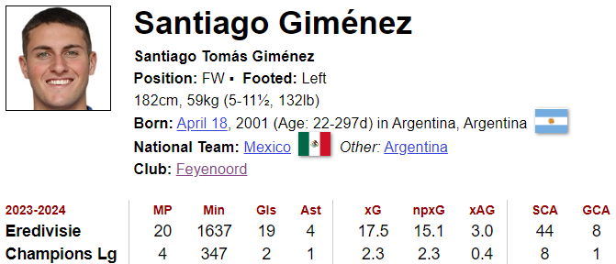
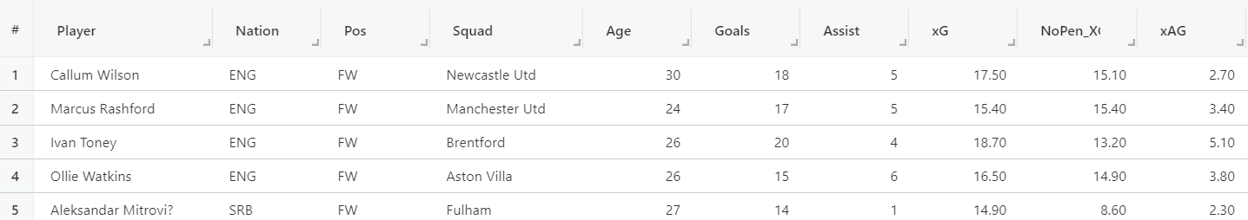
Scouting a replacement for Giménez
High probability of Santiago Giménez leaving
We’re looking for a player with similar statistics that immediately can take over his position in the team
Based on similarity, these are the top 5 candidates from the Premier League

Slide 8
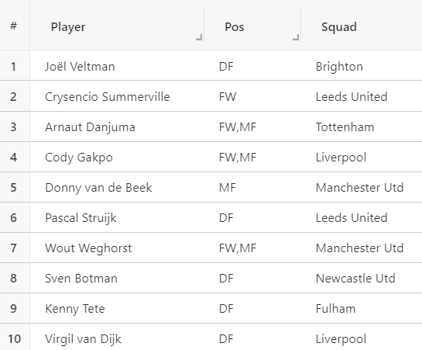
Scouting Dutch players
Feyenoord is based in The Netherlands, the coach is Dutch and a lot of the staff is Dutch. A Dutch player will therefore (most likely) feel more at home compared to an international player
I used the players statistics as performance metrics to make a ranking of the most interesting Dutch players for Feyenoord
Based on these metrics and age, these are the top 10 candidates from the Premier League

Slide 9
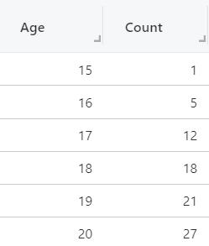
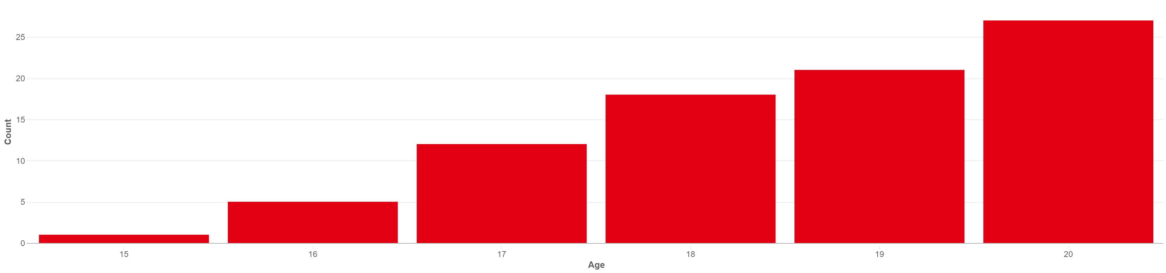
Age distribution of young players (under 21) in the Premier League
Feyenoord has to work on a tight budget compared to teams from bigger competitions. This is why their focus is usually on younger players who can be developed into better players
That’s why it’s interesting to analyse the younger players from the Premier League
The visuals above display the age distribution of young players in the Premier League

Slide 10
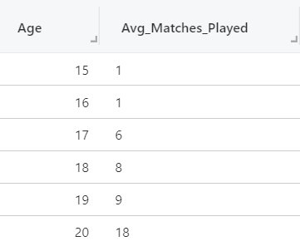
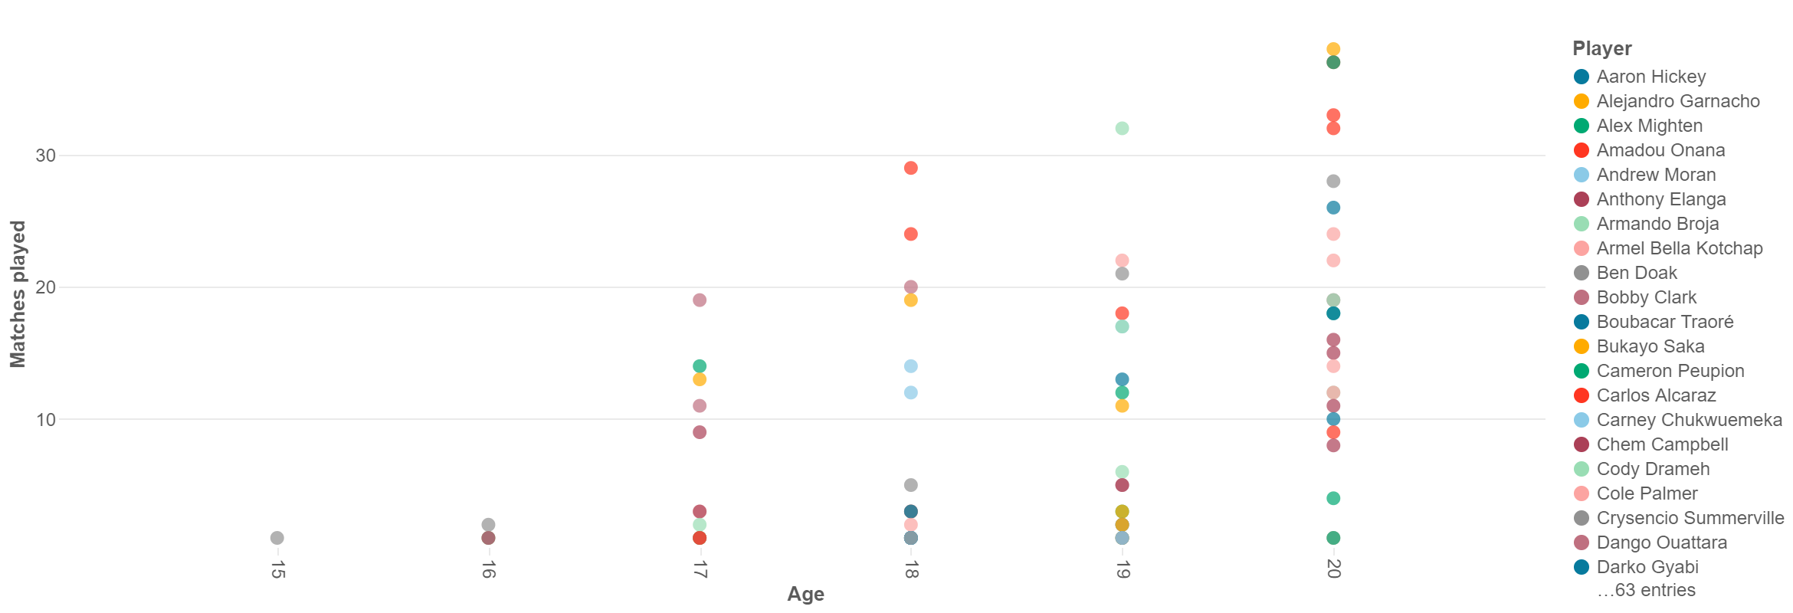
Experience/playing time of the youngsters
Young players with significant match experience could indicate their potential to become key players in the future
Young players who aren’t getting enough match time, could be interested in moving away from their respective clubs
So both parties could be interesting players for Feyenoord, that’s why a scatter plot (as shown below) focusing on matches played vs. age could be a useful visual for Feyenoord’s scouting team
Notes:
A scatter plot focusing on matches played vs. age can be a great visualization to analyze the relationship between a player's age and their match experience. Here's why it can be interesting:
Identifying Development Trends: The scatter plot can help identify trends in the number of matches played as players age. This can provide insights into how players' match experience evolves over time.
Youth vs. Experience: The plot can show whether there's a difference in match experience between younger and older players. It can help determine if younger players are given more opportunities to play or if experienced players are preferred.
Player Longevity: By analyzing the distribution of matches played across different age groups, you can assess the longevity of players' careers and determine if there are any age-related patterns in match participation.
Talent Identification: For scouting purposes, this plot can help identify young players with significant match experience, which could indicate their potential to become key players in the future.
Injury Analysis: The scatter plot can also be used to analyze the impact of injuries on players' match participation across different age groups. This can provide insights into injury risks and management strategies.
Overall, a scatter plot focusing on matches played vs. age can provide valuable insights into the match experience of players at different stages of their careers, which can be useful for talent identification, player development, and strategic decision-making in football clubs like Feyenoord Rotterdam.
Talent Identification: For scouting purposes, this plot can help identify young players with significant match experience, which could indicate their potential to become key players in the future.

Slide 11

Thank you
Questions?
max.noorland@gsom.polimi.it
Notes:
Cloud Technologies and Big Data Framework Assignment 2

